Slide 1
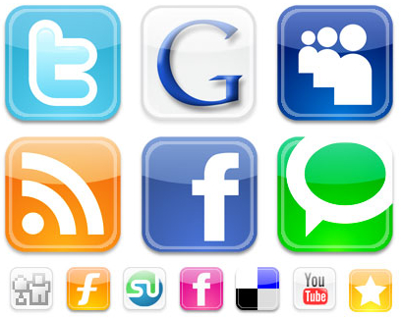
Behavior and trends by social network

Slide 2
Social network addiction
Internet addiction
Increase in tendency to multitask
Usage of social network as newsfeed
Using social media for revolution
Posting before eating

Slide 3
Social network for business
Targeting via social network
Targeted advertisements by facebook darkposts
Providing customer service via twitter
Showcasing product by using Instagram
Providing entertaining stories to customers via snapchat

